Slide 1



JAL JEEVAN MISSION
NABARD CONSULTANCY SERVICES
PROGRESS REPORT
DISTRICT: THANE
KONKAN REGION
JANUARY 2023

Slide 2
District Work Status
Taluka | Category | No. of Schemes | Work Order Issued | Work In Progress | Work Not Started
Dhule | Retro | 51 | 51 | 31 | 20
Sakri | Retro | 132 | 132 | 41 | 91
Shirpur | Retro | 66 | 66 | 47 | 19
Sindkhede | Retro | 13 | 13 | 8 | 5
Grand Total | Retro | 262 | 262 | 127 | 135

Slide 3
Executive Summary Work in Progress Schemes
Taluka | Category | Total No. of Schemes | No. of Schemes based on Physical Progress %
 |  |  | < 25% | 25 < 50% | 50 < 75% | 75 < 100% | Commissioned
Dhule | Retro | 31 | 13 | 7 | 7 | 3 | 1
Sakri | Retro | 41 | 27 | 9 | 3 | 2
Shirpur | Retro | 47 | 17 | 13 | 12 | 3 | 2
Sindkhede | Retro | 8 | 5 | 1 | 1 | 1
Grand Total | Retro | 127 | 62 | 30 | 23 | 9 | 3

Slide 4
Abstract of Schemes – Work in Progress Category – “Retro”
Sr No | Scheme Name | Name of Agency | W.O. Amount (excl GST) | W.O. Date | Construction Period | Physical Progress | RA Bill (Recommended) % | RA Bill (Recommended) In Lakhs
Dhule Taluka | Dhule Taluka
1 | Anchale Tanda | Shri Kishore Sambhaji Pawar | 62,63,862 | 22-09-2022 | 12 Months | 52.16% | - | -
2 | Behed | Keshar Construction Dhule | 41,70,903 | 21-09-2022 | 12 Months | 0.93% | - | -
3 | Bendrepada | Shri Kishore Sambhaji Pawar | 42,03,891 | 07-11-2022 | 12 Months | 9.20% | - | -
4 | Burzad | Shramgatha Associates | 95,25,433 | 11-07-2022 | 12 Months | 20.00% | - | -
5 | Chaugaon | Shri.Vighnaharta Construction Shindhkheda | 32,04,453 | 07-09-2022 | 12 Months | 12.93% | - | -
6 | Chinchwar | Mohit Nikam | 44,60,874 | 22-09-2022 | 12 Months | 81.37% | 81.13% | 36.19
7 | Deobhane | Girish Marathe | 18,52,212 | 31-01-2022 | 6 Months | 7.88% | - | -
8 | Deur Bk. | Sharad Deore | 70,91,722 | 19-04-2022 | 12 Months | 31.67% | 31.52% | 22.35
9 | Gotane | Ganesh Borse | 45,14,330 | 07-03-2022 | 12 Months | 56.87% | 53.34% | 24.08
10 | Horpada | Abhishek Chinchole | 11,06,520 | 14-03-2022 | 12 Months | 44.00% | - | -
11 | Junawane | Shri Rajendra Patil | 20,76,903 | 12-09-2022 | 6 Months | 82.39% | - | -
12 | Kalkhede | Ganesh Borse | 27,88,700 | 22-09-2022 | 12 Months | 73.87% | 73.33% | 20.45
13 | Kawathi | Shri.Vighnaharta Construction Shindhkheda | 77,57,746 | 03-02-2022 | 12 Months | 58.40% | 32.44% | 25.17

Slide 5
Abstract of Schemes – Work in Progress Category – “Retro”
Sr No | Scheme Name | Name of Agency | W.O. Amount (excl GST) | W.O. Date | Construction Period | Physical Progress | RA Bill (Recommended) % | RA Bill (Recommended) In Lakhs
14 | Khede | Shri Jitendra Patil | 39,02,792 | 24-08-2022 | 12 Months | 47.05% | - | -
15 | Kundane War | Vaibhav Mahajan | 14,40,371 | 14-07-2022 | 6 Months | 62.47% | - | -
16 | Lohgad | Shri Vaibhau Mahajan | 14,89,232 | 14-07-2022 | 6 Months | 1.00% | - | -
17 | Mordad Tanda | Shri Kishore Sambhaji Pawar | 56,85,250 | 22-09-2022 | 12 Months | 45.60% | 41.12% | 23.38
18 | Mukati | Mohit Nikam | 26,89,314 | 21-09-2022 | 12 Months | 1.85% | - | -
19 | Nagaon Bk. | Shri Kishore Sambhaji Pawar Dhule | 24,30,626 | 16-12-2022 | 12 Months | 8.00% | - | -
20 | Nandane | Shri.Vighnaharta Construction Shindhkheda | 1,84,99,918 | 08-09-2022 | 12 Months | 2.00% | - | -
21 | Raver | Lalit Dadasaheb Salunkhe | 11,02,807 | 22-09-2022 | 12 Months | 62.50% | 61.77% | 6.81
22 | Padalde | Rajendra Vikas Patil | 42,38,637 | 02-12-2022 | 12 Months | 3.00% | - | -
23 | Satarne | Shri Kishore Sambhaji Pawar | 18,78,753 | 31-01-2022 | 6 Months | 50.38% | - | -
24 | Sayane | Shri.Vighnaharta Construction | 60,29,891 | 24-08-2022 | 12 Months | 75.28% | 73.44% | 44.28
25 | Shirdhane Pr. Dangri | Shri Kishore Sambhaji Pawar Dhule | 58,54,129 | 22-09-2022 | 12 Months | 26.49% | 12.20% | 7.14
26 | Sonewadi | Ganesh Borse | 38,15,273 | 07-11-2022 | 12 Months | 8.00% | - | -
27 | Sukawad Pr. Dangri | Shri Kishore Sambhaji Pawar | 34,74,340 | 16-03-2022 | 12 Months | 26.15% | 20.55% | 7.14

Slide 6
Abstract of Schemes – Work in Progress Category – “Retro”
Sr No | Scheme Name | Name of Agency | W.O. Amount (excl GST) | W.O. Date | Construction Period | Physical Progress | RA Bill (Recommended) % | RA Bill (Recommended) In Lakhs
28 | Velhane | Rushikesh Nerkar | 21,61,406 | 19-12-2022 | 12 Months | 30.01% | - | -
29 | Hendrun | Ganesh Borse | 96,13,779 | 10-06-2022 | 13 Months | 4.02% | - | -
30 | Tamaswadi | Sawami Vivekanda Society | 17,40,372 | 16-02-2023 |  | 2.00% | - | -
Sakri Taluka | Sakri Taluka
31 | Ashtane | Sushil Desale | 61,10,133 | 16-12-2022 | 12 Months | 1.00% | - | -
32 | Bhadane | Shri Prafful Bedase Nashik | 1,24,87,221 | 12-09-2022 | 12 Months | 30.07% | - | -
33 | Bhagapur | Arun Patil | 24,46,782 | 29-12-2022 | 12 Months | 10.00% | - | -
34 | Bhortipada | Shri Sushil Desale Kasare | 59,49,254 | 03-02-2022 | 12 Months | 29.00% | - | -
35 | Chhavadi | Deepak Chaudary | 79,88,673 | 18-10-2022 | 12 Months | 39.20% | - | -
36 | Chinchpada | Raju Borse | 3,52,22,564 | 12-10-2022 | 12 Months | 25.00% | - | -
37 | Darkhel | Shri Kishore Sambhaji Pawar Dhule | 27,60,749 | 31-01-2022 | 12 Months | 71.03% | - | -
38 | Degaon | Shri Sushil Desale Kasare | 47,57,225 | 18-10-2022 | 12 Months | 10.00% | - | -
39 | Dhaner | Sushil Desale | 31,26,114 | 27-12-2022 | 12 Months | 44.75% | - | -
40 | Dighave | Sushil Desale | 22,37,992 | 01-10-2022 | 12 Months | 10.00% | - | -

Slide 7
Abstract of Schemes – Work in Progress Category – “Retro”
Sr No | Scheme Name | Name of Agency | W.O. Amount (excl GST) | W.O. Date | Construction Period | Physical Progress | RA Bill (Recommended) % | RA Bill (Recommended) In Lakhs
41 | Gangapur | Sarsvati Majoor Sahkari Sanstha Pratappur | 14,44,083 | 31-01-2022 | 12 Months | 83.87% | 83.10% | 12.00
42 | Gavhanipada | Sushil Desale | 47,35,963 | 18-10-2022 | 12 Months | 35.20% | - | -
43 | Ghodade | Deepak Chaudary | 25,60,718 | 31-01-2022 | 9 Months | 21.32% | - | -
44 | Jaitane | Jitendra Patil | 4,01,07,614 | 29-11-2022 | 12 Months | 16.45% | - | -
45 | Jambhore | Sushil Desale | 28,82,919 | 18-10-2022 | 12 Months | 5.00% | - | -
46 | Jebapur | R.V Desale | 39,92,902 | 30-01-2023 | 12 Months | 9.18% | - | -
47 | Kadupada | Rajendra Pandit Borse | 68,43,675 | 01-10-2022 | 12 Months | 30.00% | - | -
48 | Kalambhir | Sharad Deore | 48,51,355 | 27-06-2022 | 12 Months | 16.33% | - | -
49 | Khandbara | Ganesh Borse | 1,18,10,493 | 16-12-2022 | 12 Months | 9.00% | - | -
50 | Kharadbari | Sachin Pandit Shinde | 70,20,946 | 01-10-2022 | 12 Months | 30.00% | - | -
51 | Lonkhedi | Sushil Dattatray Desale Kasare | 75,86,321 | 16-12-2022 | 12 Months | 15.00% | - | -
52 | Malpur | Kautubh Patil Dhule | 12,84,957 | 10-02-2022 | 12 Months | 9.00% | - | -
53 | Mohane | Shri Vighnhatra Construction | 1,15,70,683 | 20-12-2022 | 12 Months | 4.00% | - | -
54 | Nandarkhi | Ganesh Borse | 64,89,052 | 10-01-2022 | 12 Months | 5.87% | - | -

Slide 8
Abstract of Schemes – Work in Progress Category – “Retro”
Sr No | Scheme Name | Name of Agency | W.O. Amount (excl GST) | W.O. Date | Construction Period | Physical Progress | RA Bill (Recommended) % | RA Bill (Recommended) In Lakhs
55 | Nandvan | Rajendra Desale | 63,93,856 | 18-10-2022 | 12 Months | 5.00% | - | -
56 | Nawadane | Sachin Society | 19,97,793 | 07-02-2022 | 12 Months | 65.66% | - | -
57 | Nawapada | Sachin Shinde | 88,39,994 | 07-03-2022 | 12 Months | 5.00% | - | -
58 | Pankheda | Shri Vicky Kokani Ambapada | 14,22,001 | 31-03-2022 | 12 Months | 2.00% | - | -
59 | Perejpur | Jitendra Patil | 94,73,558 | 29-11-2022 | 12 Months | 3.89% | - | -
60 | Petale | Shri Vighnhatra Construction | 23,91,522 | 27-07-2022 | 12 Months | 16.03% | - | -
61 | Phopade | GP | 14,39,705 | 12-10-2022 | 12 Months | 50.00% | - | -
62 | Pobare | Shri Sushil Desale Kasare | 75,69,956 | 24-08-2022 | 12 Months | 10.00% | - | -
63 | Pratappur | Man Mohhan Singh Rajput | 19,09,321 | 28-06-2022 | 6 Months | 0.77% | - | -
64 | Ranjangaon | Sachin Society | 25,55,641 | 24-01-2023 | 12 Months | 30.00% | - | -
65 | Rohod | Sachin Shinde | 29,14,039 | 25-04-2022 | 12 Months | 21.91% | - | -
66 | Shivajinagar | Sachin Shinde | 36,16,230 | 02-02-2022 | 12 Months | 75.00% | 30.53% | 11.04
67 | Umarpata | Abhijit Rathod | 1,01,83,351 | 29-11-2022 | 12 Months | 0.99% | - | -
68 | Umbhare | Rajendra Desale | 29,54,160 | 18-10-2022 | 12 Months | 12.73% | - | -

Slide 9
Abstract of Schemes – Work in Progress Category – “Retro”
Sr No | Scheme Name | Name of Agency | W.O. Amount (excl GST) | W.O. Date | Construction Period | Physical Progress | RA Bill (Recommended) % | RA Bill (Recommended) In Lakhs
69 | Vasmar | Sharad Anantrao Deore | 98,99,641 | 16-12-2022 | 12 Months | 10.00% | - | -
70 | Virkhel | Sushil Desale | 48,33,390 | 27-12-2022 | 12 Months | 2.00% | - | -
71 | Vitai | Mayur Mahajan | 20,51,596 | 22-09-2022 | 6 Months | 2.82% | - | -
Shirpur Taluka | Shirpur Taluka
72 | Ahilyapur | Shri Kishore Sambhaji Pawar Dhule | 60,20,000 | 22-09-2022 | 12 Months | 5.81% | - | -
73 | Ajande Bk. | Mohit Nikam | 42,22,495 | 22-09-2022 | 12 Months | 48.28% | 48.04% | 20.28
74 | Ajnad | Chandrashekhar Rajput | 21,63,617 | 05-08-2022 | 12 Months | 64.10% | 54.91% | 11.88
75 | Ambe | Balaji Infrastructure Arthe B. | 4,26,63,100 | 14-03-2022 | 12 Months | 70.36% | - | -
76 | Arthe Bk. | Md Infrastructure | 1,14,77,906 | 27-06-2022 | 15 Months | 46.19% | - | -
77 | Arthe Kh. | Md Infrastructure | 1,21,43,722 | 27-06-2022 | 15 Months | 44.97% | - | -
78 | Bharvade | Ganesh Borse | 34,09,278 | 24-04-2022 | 12 Months | 56.76% | 53.13% | 18.11
79 | Bhatane | Narendra Sahebrao Patil | 1,04,72,486 | 05-08-2022 | 12 Months | 31.76% | - | -
80 | Bhatpura | Shri Vighnhatra Construction | 37,18,000 | 08-09-2022 | 12 Months | 2.00% | - | -
81 | Bhoiti | Shri Vighnhatra Construction | 50,57,000 | 14-03-2022 | 12 Months | 12.30% | - | -

Slide 10
Abstract of Schemes – Work in Progress Category – “Retro”
Sr No | Scheme Name | Name of Agency | W.O. Amount (excl GST) | W.O. Date | Construction Period | Physical Progress | RA Bill (Recommended) % | RA Bill (Recommended) In Lakhs
82 | Bhortek | Ganesh Borse | 21,14,000 | 01-09-2022 | 12 Months | 8.32% | - | -
83 | Chandpuri | Ganesh Borse | 79,67,677 | 01-09-2022 | 12 Months | 59.10% | 58.38% | 46.52
84 | Gartad | Shri Vighnhatra Construction | 35,28,737 | 03-02-2022 | 12 Months | 41.02% | - | -
85 | Gidhade | Shri Vighnhatra Construction | 20,21,882 | 29-04-2021 | 12 Months | 39.42% | - | -
86 | Godi | Shri Kishore Sambhaji Pawar | 29,74,029 | 04-11-2022 | 12 Months | 75.00% | 33.50% | 9.96
87 | Hated | Shri Kishore Sambhaji Pawar | 39,33,606 | 12-10-2022 | 12 Months | 2.00% | - | -
88 | Higaon | Narendra Sahebrao Patil | 19,20,570 | 31-01-2022 | 12 Months | 90.00% | - | -
89 | Hingoni Bk. | Girish Thakre | 27,94,000 | 24-01-2023 | 12 Months | 2.00% | - | -
90 | Hingonipada | Kamlesh Patil | 22,22,000 | 28-11-2022 | 12 Months | 3.46% | - | -
91 | Jalod | Shramgatha Associates Malegaon | 56,75,335 | 25-03-2021 | 12 Months | 35.77% | - | -
92 | Jatoda | Deomogra Adiwasi Society Joyada | 21,37,000 | 05-08-2022 | 12 Months | 2.78% | - | -
93 | Kadhaipani | Shri Ketan L Patil | 17,00,843 | 21-10-2022 | 9 Months | 57.00% | - | -
94 | Kakadmal | Dhandai.M.Sah.Khalane | 18,85,000 | 16-12-2022 | 12 Months | 5.00% | - | -
95 | Kalamsare | Shri Kishore Sambhaji Pawar | 35,79,204 | 04-02-2022 | 12 Months | 35.64% | - | -

Slide 11
Abstract of Schemes – Work in Progress Category – “Retro”
Sr No | Scheme Name | Name of Agency | W.O. Amount (excl GST) | W.O. Date | Construction Period | Physical Progress | RA Bill (Recommended) % | RA Bill (Recommended) In Lakhs
96 | Kalapani | Dhandai.M.Sah.Khalane | 29,45,324 | 26-09-2022 | 12 Months | 26.71% | - | -
97 | Karvand | Shri Nilesh Nile | 43,80,000 | 10-11-2022 | 12 Months | 4.21% | - | -
98 | Kharikhan | Shri Rajendra Patil | 19,30,957 | 13-10-2022 | 12 Months | 62.30% | 28.33% | 5.47
99 | Kurkhali | Krishna Sonwane | 19,75,000 | 02-05-2022 | 12 Months | 11.03% | - | -
100 | Londhare | Shramgatha Associates Malegaon | 88,13,690 | 22-09-2022 | 12 Months | 62.37% | - | -
101 | Nandarde | Akash Nikam | 19,55,000 | 28-11-2022 | 12 Months | 4.00% | - | -
102 | Panakhad | Shri C. G. Rajput | 55,35,000 | 29-11-2022 | 12 Months | 10.00% | - | -
103 | Rudawali | Durgadas Pawar | 23,70,775 | 14-03-2022 | 12 Months | 52.38% | - | -
104 | Savalde | Shri Kishore Sambhaji Pawar | 21,17,331 | 19-04-2022 | 12 Months | 87.02% | 59.27% | 12.55
105 | Subhash Nagar | Narendra Sahebrao Patil | 74,14,485 | 04-11-2022 | 12 Months | 24.53% | 17.81% | 13.21
106 | Tande | Sagar Pawar | 45,81,000 | 20-12-2022 | 12 Months | 6.00% | - | -
107 | Taradi | Durgesh Patil | 19,84,333 | 02-05-2022 | 12 Months | 34.83% | 33.15% | 6.58
108 | Tarhadi Taraf Tarhad | Shri Vighnhatra Construction | 1,07,59,011 | 08-09-2022 | 12 Months | 31.80% | 30.87% | 33.21
109 | Umarda | Ketan Patil | 17,00,843 | 12-10-2022 | 12 Months | 50.00% | 49.49% | 8.42

Slide 12
Abstract of Schemes – Work in Progress Category – “Retro”
Sr No | Scheme Name | Name of Agency | W.O. Amount (excl GST) | W.O. Date | Construction Period | Physical Progress | RA Bill (Recommended) % | RA Bill (Recommended) In Lakhs
110 | Untawad | Narendra Sahebrao Patil | 21,26,940 | 19-04-2022 | 12 Months | 59.39% | 59.15% | 12.58
111 | Vadel Kh | Shri Kishore Sambhaji Pawar | 19,29,000 | 15-03-2022 | 12 Months | 58.00% | - | -
112 | Vakwad | Shri Vighnhatra Construction | 50,24,298 | 14-03-20222 | 12 Months | 33.50% | 32.81% | 16.48
113 | Vikharan Bk. | Sarsvati Majoor Sahkari Sanstha Pratappur | 21,28,875 | 07-03-2022 | 12 Months | 59.15% | 58.95% | 12.55
114 | Waghadi | Narendra Sahebrao Patil | 47,13,481 | 19-04-2022 | 12 Months | 34.26% | - | -
115 | Wathode | Ganesh Borse | 34,07,000 | 21-11-2022 | 12 Months | 10.43% | - | -
116 | Zendeanjan | Ganesh Borse | 66,24,000 | 07-11-2022 | 12 Months | 0.01% | - | -
Sindkhede Taluka | Sindkhede Taluka
117 | Amalthe | Manish Pawar | 76,92,991 | 11-11-2022 | 12 Months | 5.00% | - | -
118 | Bhilane D. | Dhandai.M.Sah.Sau.Khalane | 15,09,255 | 06-10-2022 | 12 Months | 22.93% | - | -
119 | Hispur | Nilesh Nile | 14,87,736 | 31-10-2022 | 6 Months | 2.00% | - | -
120 | Humbarde | Pawan Dilip Pawar | 24,89,729 | 29-12-2022 | 12 Months | 2.00% | - | -
121 | Langhane | Narendra Sahebrao Patil | 48,51,329 | 31-10-2022 | 12 Months | 54.86% | - | -
122 | Shendwade | Shri Kishore Sambhaji Pawar | 28,41,878 | 28-11-2022 | 12 Months | 24.59% | - | -

Slide 13
Abstract of Schemes – Work in Progress Category – “Retro”
Sr No | Scheme Name | Name of Agency | W.O. Amount (excl GST) | W.O. Date | Construction Period | Physical Progress | RA Bill (Recommended) % | RA Bill (Recommended) In Lakhs
123 | Valkhede | Durgadas Pawar | 54,90,705 | 22-09-2022 | 12 Months | 99.02% | 24.06% | 13.21
124 | Zotwade | Gaurav.M.Sah.Sau.Khalane | 28,27,285 | 07-03-2022 | 12 Months | 38.34% | 37.66% | 10.65

Slide 14
Abstract of Schemes – Work Completed Category – “Retro”
Sr No | Scheme Name | Name of Agency | W.O. Amount (excl GST) | W.O. Date | Construction Period
Dhule Taluka | Dhule Taluka
1 | Borkund | Shri Kishore Sambhaji Pawar Dhule | 17,34,034 | 31-01-2022 | 6 Months
Shirpur Taluka | Shirpur Taluka
2 | Gurhadpani | Dhandai.M.Sah.Sau.Khalane | 20,34,287 | 24-03-2022 | 12 Months
3 | Hivarkheda |  | 19,06,616 |  | 12 Months

Slide 15
DASHBOARD

Slide 16
Dashboard
Work Status

Slide 17
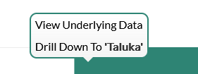
Dashboard
Progress Milestone

Slide 18
Dashboard
Work Status:
Work Status: Taluka Wise

Slide 19
MS – PROJECT
Work in Progress Schemes

Slide 20
Project Overview Physical Progress vs Financial Progress vs Time Overrun

Slide 21
Late Schemes

Slide 22
SAMPLE SITE VISIT PHOTOS

Slide 23
, Tal.

Slide 24
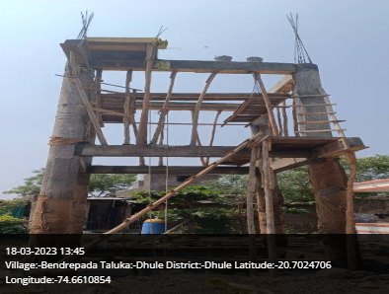
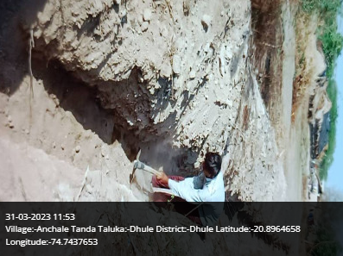
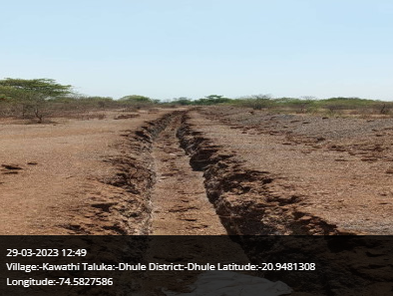
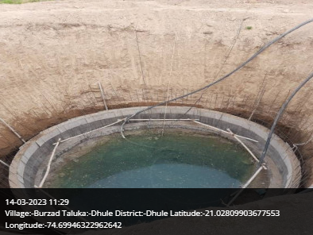
Dhule Taluka

Slide 25
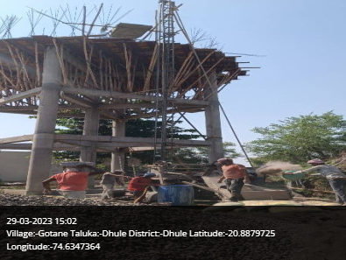
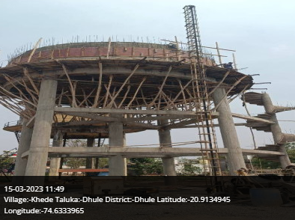
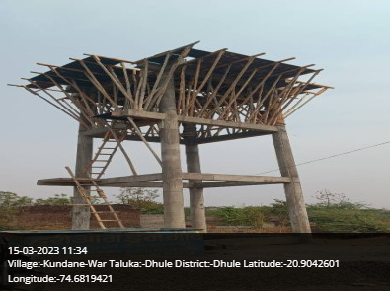
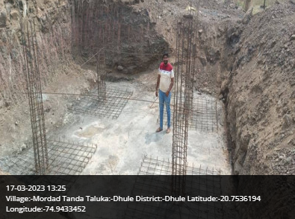
Dhule Taluka

Slide 26
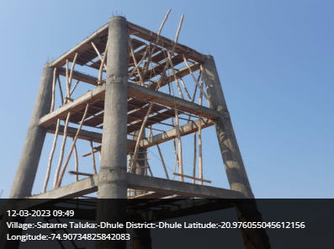
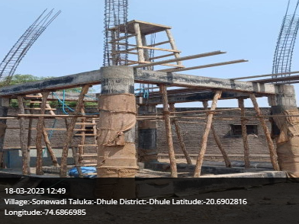
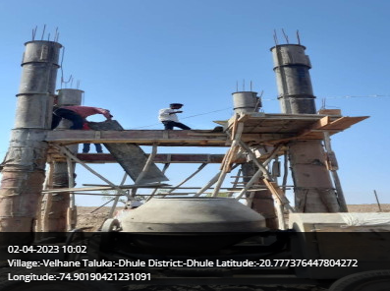
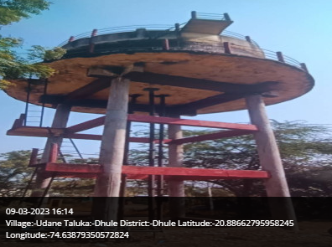
Dhule Taluka

Slide 27
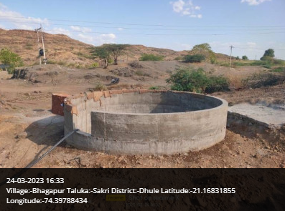
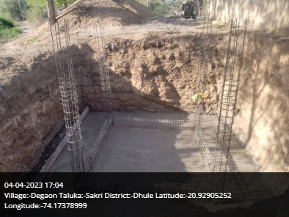
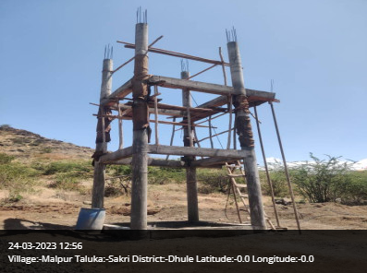
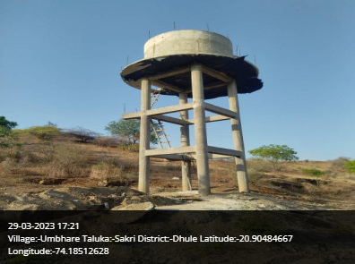
Sakri Taluka

Slide 28
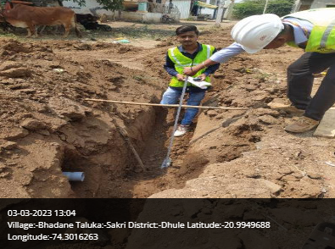
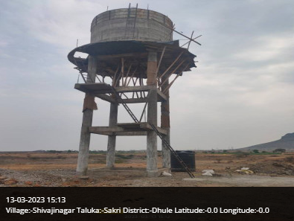
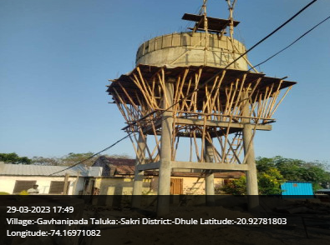
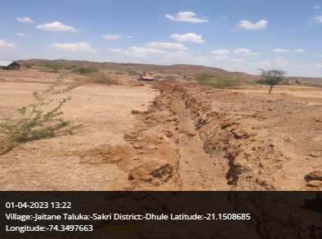
Sakri Taluka

Slide 29
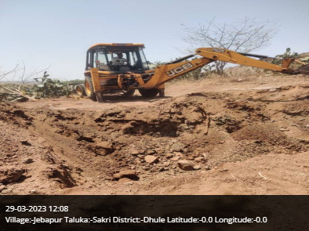
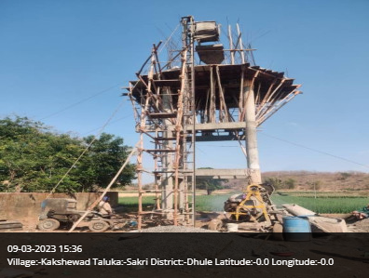
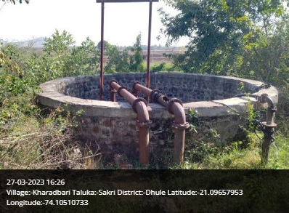
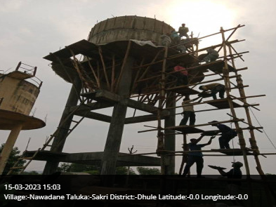
Sakri Taluka

Slide 30
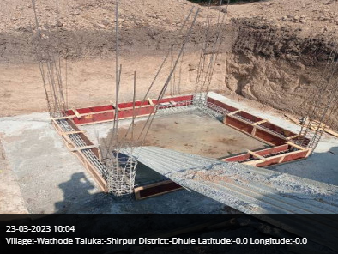
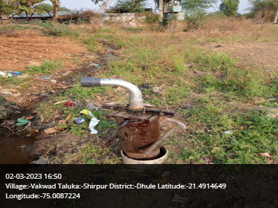
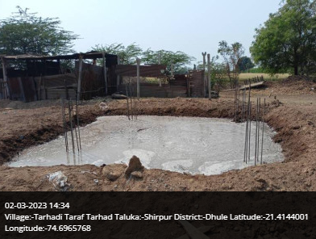
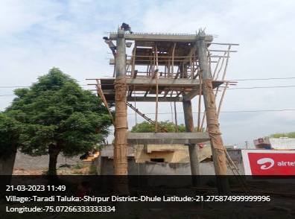
Shirpur Taluka

Slide 31
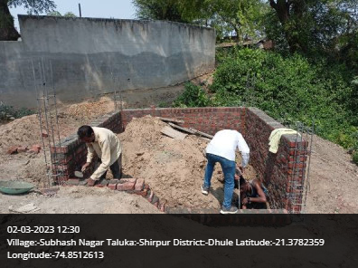
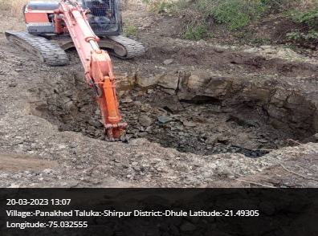
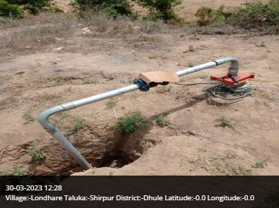
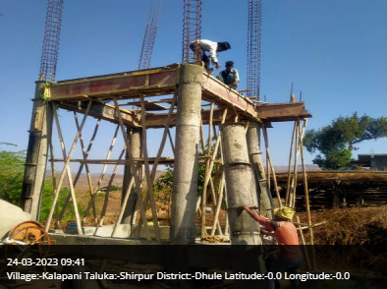
Shirpur Taluka

Slide 32
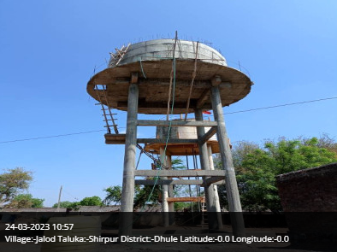
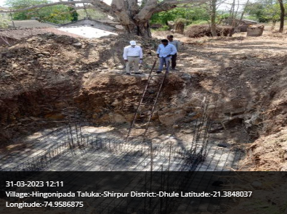
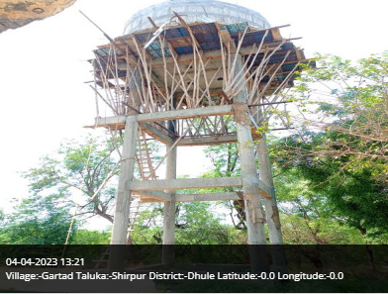
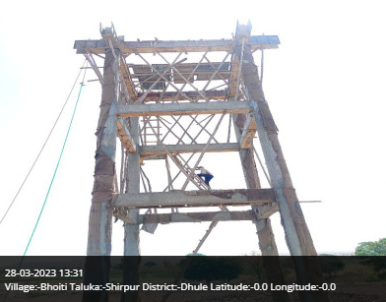
Shirpur Taluka

Slide 33
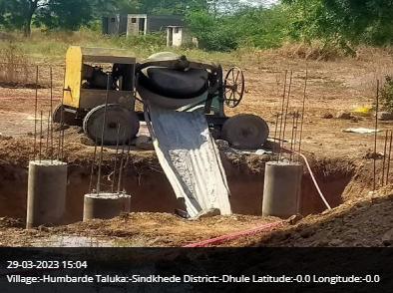
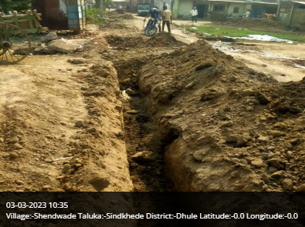
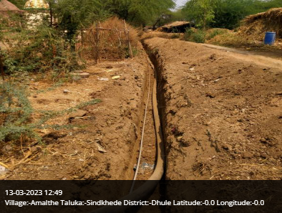
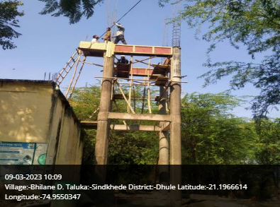
Sindhede Taluka

Slide 34

Thank You!

